Slide 1
Inventory Management System: Semester 1 Demo
By:
David Erickson
August Davis
Christian Hansen

Slide 2
Our goals
Create an inventory system application that:
Can scan the barcodes located on all department equipment
Makes accessing and modifying inventory data easy for the user
Protects the inventory data from unauthorized actions
Runs on Android
Document the project in a way that will allow others to easily continue development on the project without us

Slide 3
The Road so far
We have divided the project in to three parts:
The backend database
Scanning the barcodes in to the application
The main GUI/application

Slide 4
Progress on database
We know where we want to host it and are waiting on NDUS for permission
We have all of our fields mapped out based on the current inventory system
SQL Server 2017 will be used
Stored procedures/queries have been started

Slide 5
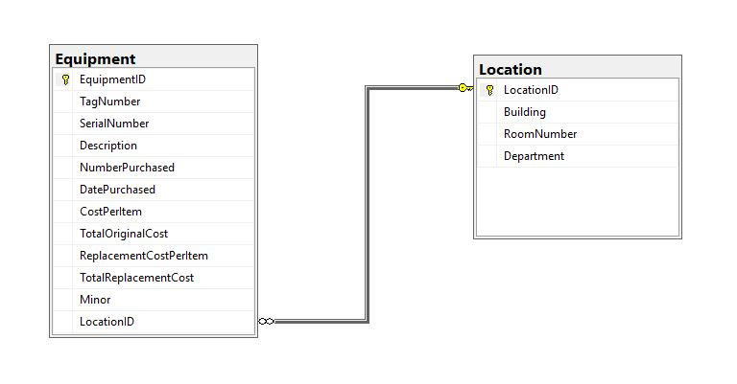
Database diagram

Slide 6
Progress on barcode scanning
The original plan was to use Google Vision to scan our barcodes, this was not compatible with our vision.
Plan B is the Zebra crossing app or a library port of it via XZing.Net.Moblie
Due to an unfamiliarity with the library, C#, and Visual Studio, we are currently in the experimentation phase of getting this component working and integrated in to the main application GUI.

Slide 7
Main Application GUI
We currently have a working prototype GUI up and working.
We will be using this as our base for adding functionality moving forward.
This shows the basic features and input we will need to work with.

Slide 8
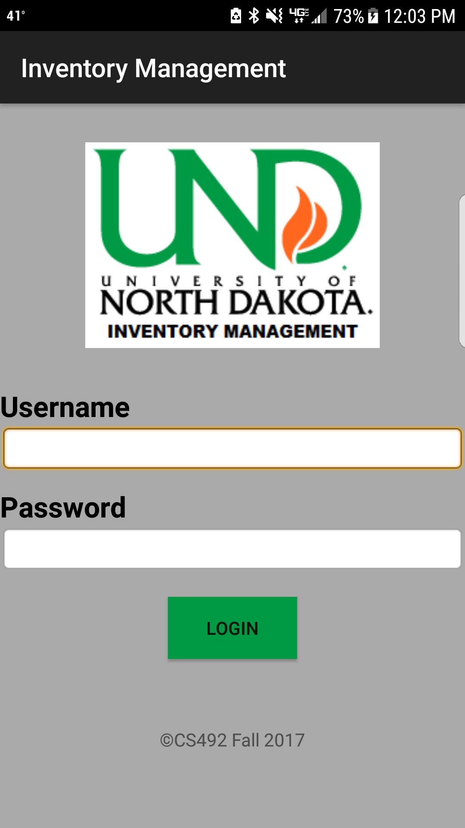
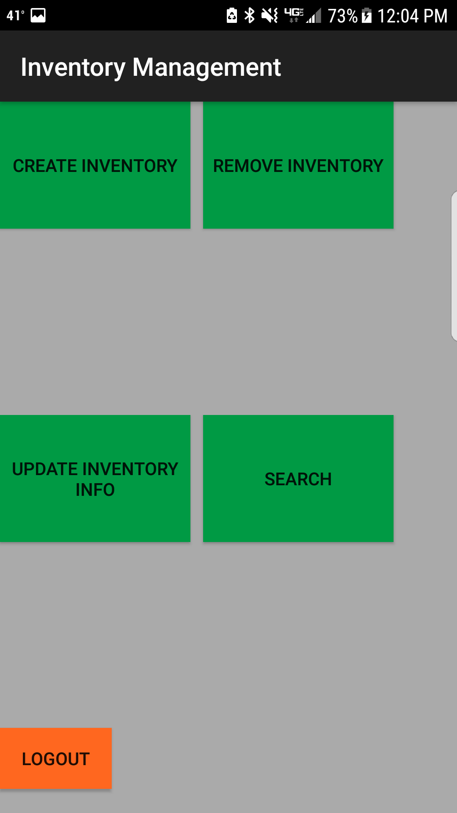
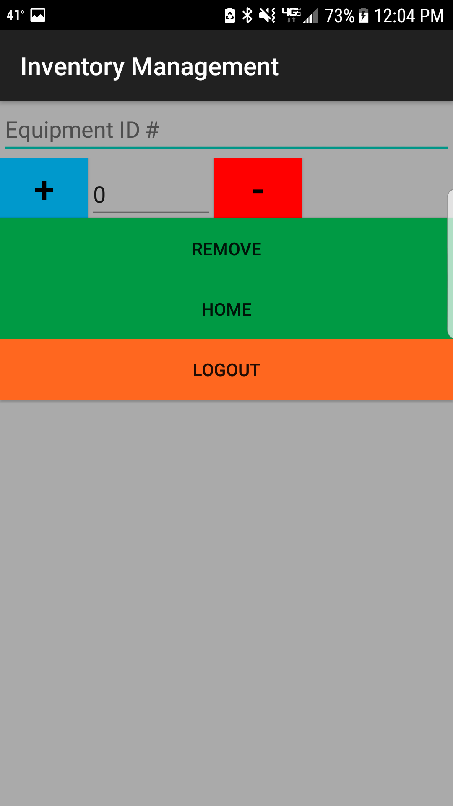

Slide 9
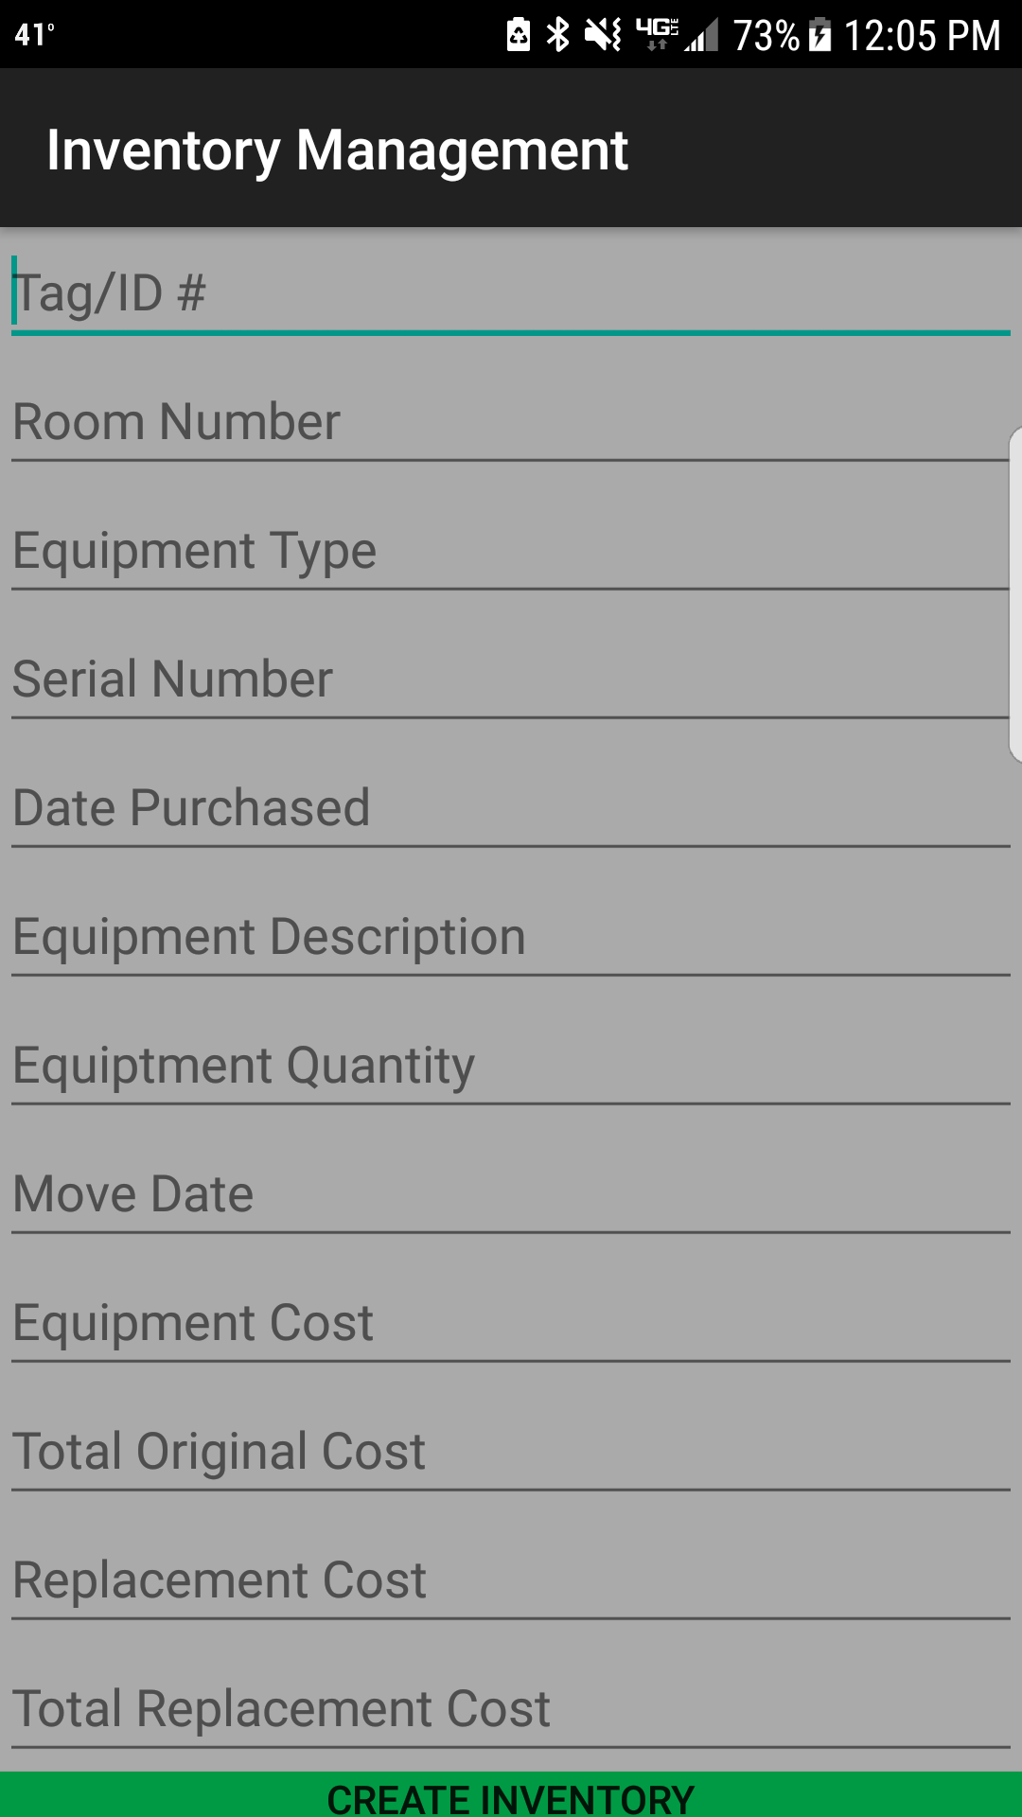
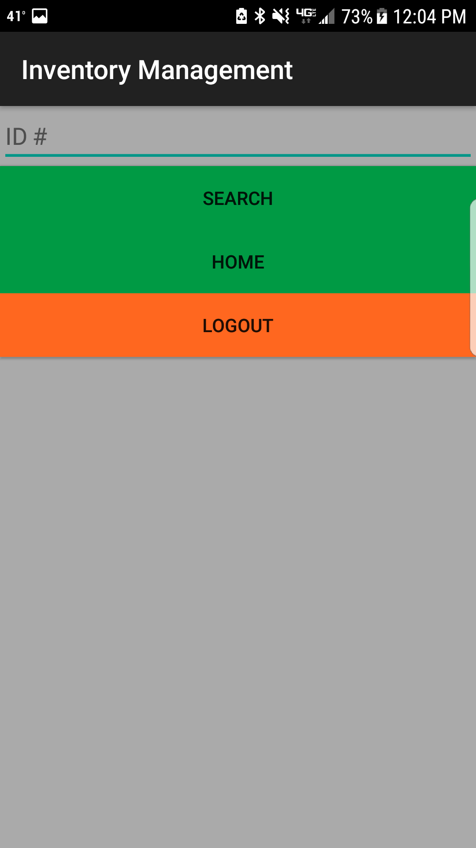
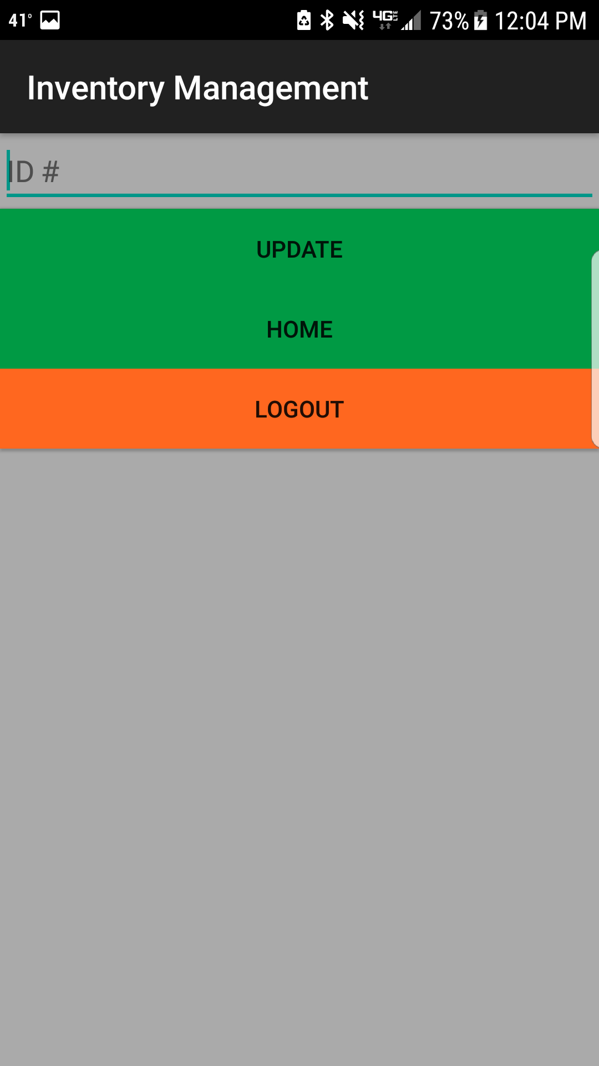

Slide 10
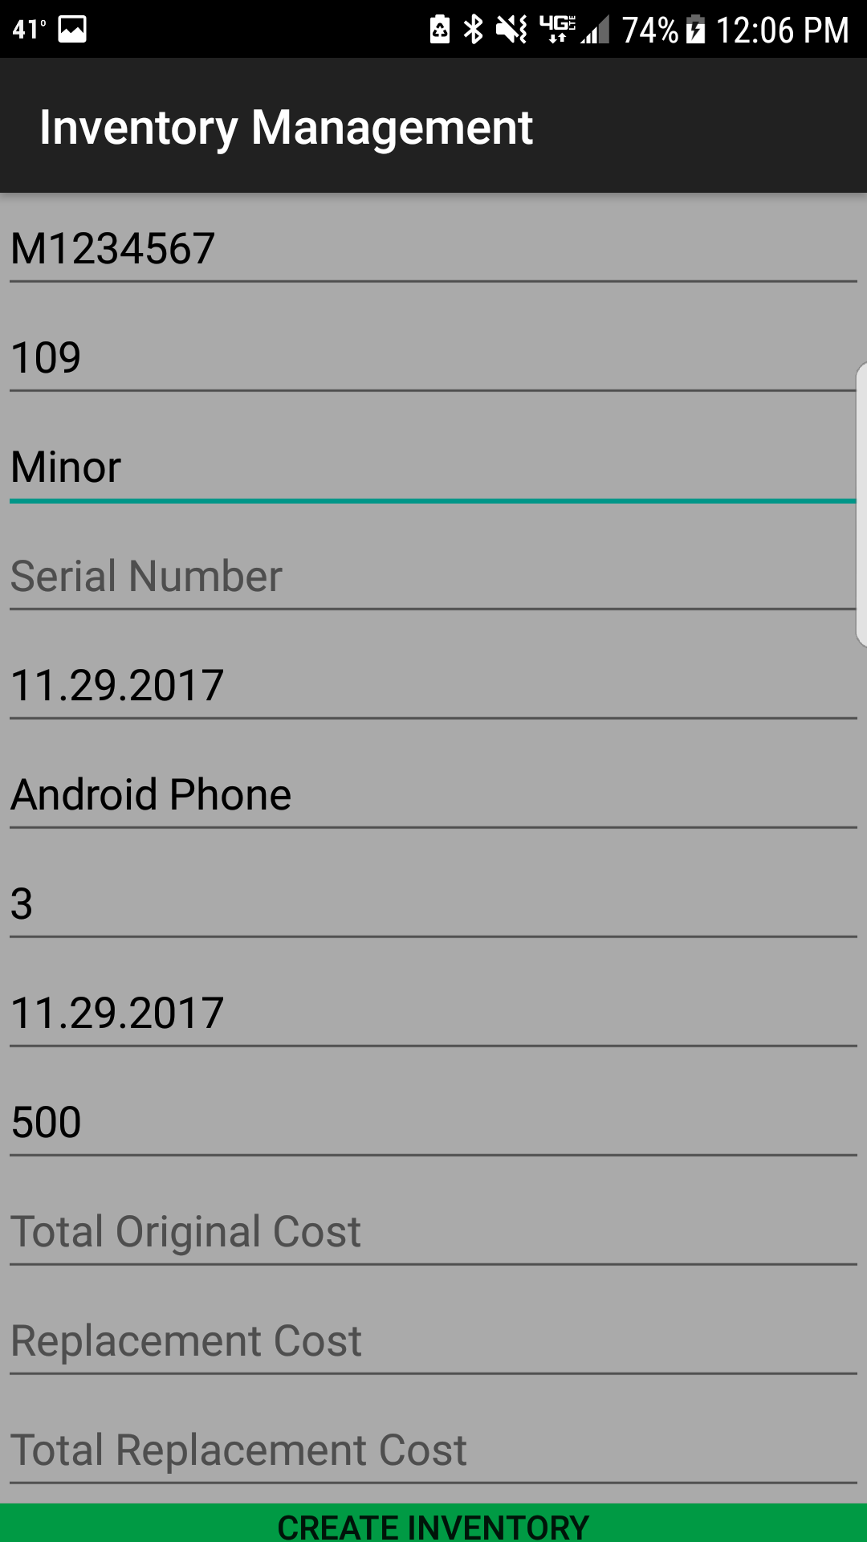

Slide 11
The immediate Road ahead: (now – end of winter break)
Develop a better understanding of how to use Zebra Crossing and XZing.Net.Moblie
Continue to improve the GUI prototype
Add more documentation to the project
Making test version of the database to work with until the real one is deployed

Slide 12
Further down the road: (next Semester)
Create and deploy our database
Write web hooks and queries to connect UI to our database
add the appropriate security measures
Integrate Zebra crossing into our application
Finalize our GUI
Connecting to the NDUS account system or creating our own account system
Package our documentation and Application in a way that makes its use easy for future developers to work with.

